Slide 1

Fine-Tuning Pythia-1B for Sentiment Classification Using LoRA
Full fine-tuning of large language models demands huge resources. We explore Parameter-Efficient Fine-Tuning (PEFT) with LoRA to update small adapter weights efficiently. Our goal is to fine-tune Pythia-1B for binary sentiment classification on the Amazon Polarity Dataset. Additionally, we perform hyperparameter tuning across multiple training runs to optimize model performance.
by Guardians Of The Galaxy
Notes:
Hello everyone! Today, we’ll be presenting our project titled 'Fine-Tuning Pythia-1B for Sentiment Classification Using LoRA.’
Fine-tuning large language models from scratch usually requires tremendous amounts of computing resources.
To address this, we explore Parameter-Efficient Fine-Tuning, or PEFT, using LoRA — which allows us to efficiently update only small adapter weights instead of the full model.
Our main goal is to fine-tune the Pythia-1B model to perform binary sentiment classification using the Amazon Polarity Dataset.
In addition to applying LoRA, we also performed hyperparameter tuning across multiple training runs. This helped us optimize the model’s performance while keeping the process resource-efficient."

Slide 2

Dataset Overview
The Amazon Polarity Dataset has millions of product reviews labeled positive or negative. We sampled 10,000 reviews for faster training and balanced classes evenly.
Dataset Size
Sampled Data
Millions of labeled product reviews
10,000 reviews for efficient training
Class Balance
Maintained approximately equal positive and negative reviews
Notes:
For our dataset, we used the Amazon Polarity Dataset, which contains millions of product reviews, each labeled as either positive or negative.
Since full-scale training on millions of examples would be very resource-intensive, we sampled 10,000 reviews to make training more efficient.
We also made sure to balance the classes evenly, maintaining an approximately equal number of positive and negative reviews.
This setup helps the model learn sentiment classification effectively without being biased toward one class.

Slide 3

Model Overview + PEFT & LoRA
Model Overview
Base model: EleutherAI/Pythia-1B-Deduped (GPT-style decoder-only transformer).
1.3 billion parameters.
The base model weights were kept frozen during fine-tuning.
Parameter-Efficient Fine-Tuning (PEFT)
PEFT allows updating only a small fraction of model parameters.
Reduces compute and memory costs significantly.
LoRA Application
LoRA adapters injected into attention layers:
Initially: q_proj, v_proj
Later (Run 4): query_key_value, dense_h_to_4h also targeted.
Enabled efficient adaptation without touching full model weights.
Quantization
Applied 4-bit quantization using the BitsAndBytes library.
Helped reduce memory footprint and speed up training on limited hardware.
Notes:
For our model, we used EleutherAI’s Pythia-1B-Deduped, a GPT-style transformer with 1.3 billion parameters.
We kept the base weights frozen and applied Parameter-Efficient Fine-Tuning, or PEFT, which updates only a small fraction of parameters to save compute and memory.
We implemented LoRA adapters into the model’s attention layers — initially targeting q_proj and v_proj, and later expanding to query_key_value and dense_h_to_4h for better results.
Finally, we used 4-bit quantization with BitsAndBytes to further reduce memory usage and speed up training on limited hardware.

Slide 4

Data Preparation & Tokenization
Training Setup
Optimizer
AdamW optimizer used for parameter updates.
Reformatting
Learning Rate
Reviews reformatted into
instruction-tuning prompts:
"Classify the sentiment of this review: {text}"
LR range: 3e-4 to 2e-4 across different runs.
Batch Size
Small, set to 4
Tokenizer
Epochs
Tokenized using Pythia-1B tokenizer to
generate model-ready inputs.
Initial experiments: 1 epoch.
Final best model (Run 4): trained for 2 epochs for
improved performance.
Notes:
For data preparation, we reformatted the Amazon reviews into instruction-tuning prompts, phrased like: 'Classify the sentiment of this review: {text}.’
This helps guide the model more effectively during fine-tuning.
We then tokenized the prompts using the Pythia-1B tokenizer, converting them into model-ready inputs.
For training, we used the AdamW optimizer to update parameters.
Our learning rate varied between 3e-4 and 2e-4 across different runs.
We kept the batch size small at 4, which helped manage memory limits.
In terms of epochs, we initially trained for just 1 epoch, but for our final and best-performing model, we trained for 2 epochs to improve results without overfitting.

Slide 5
Fine-Tuning Pipeline
Dataset Loading
Model Setup
Amazon Polarity — positive/negative
review labels
Load Pythia-1B model with
LoRA adapters injected.
Preprocessing
Fine-tuning
Format reviews into instruction-tuning
prompt format.
Train only LoRA params with
AdamW and LR scheduler
Evaluation
Tokenization
Greedy decoding; measure
Accuracy and Macro-F1
Tokenize prompts using Pythia tokenizer.
Notes:
Our fine-tuning pipeline followed a clear, structured process:
First, we loaded the Amazon Polarity dataset, which contains positive and negative review labels.
Next, we preprocessed the reviews by formatting them into instruction-tuning prompts to guide the model.
After that, we tokenized the prompts using the Pythia tokenizer to prepare the data for the model.
For the model setup, we loaded the Pythia-1B model and injected LoRA adapters into it to enable parameter-efficient training.
During fine-tuning, we trained only the LoRA parameters, using the AdamW optimizer along with a learning rate scheduler to manage learning rates across epochs.
Finally, for evaluation, we used greedy decoding and measured performance based on Accuracy and Macro-F1 Score

Slide 6

Evaluation Strategy and Metrics
Decoding Strategy
Greedy Decoding used for generating sentiment predictions.
Maximum New Tokens: 20 tokens per prediction.
Evaluation Metrics
Accuracy: Percentage of correctly predicted labels.
Macro-Averaged F1 Score: Harmonic mean of precision and recall, averaged across both classes.
Confusion Matrix: Visual analysis of correct vs incorrect predictions for positive and
negative labels.
Notes:
For evaluation, we used a greedy decoding strategy to generate sentiment predictions.
We limited the model to a maximum of 20 new tokens per prediction to keep the outputs focused and consistent.
In terms of evaluation metrics, we tracked three key measures: First, Accuracy, which is simply the percentage of correctly predicted labels. Second, the Macro-Averaged F1 Score, which balances precision and recall equally across both the positive and negative classes. And third, we used a Confusion Matrix to visually analyze how often the model correctly versus incorrectly classified each sentiment label.

Slide 7
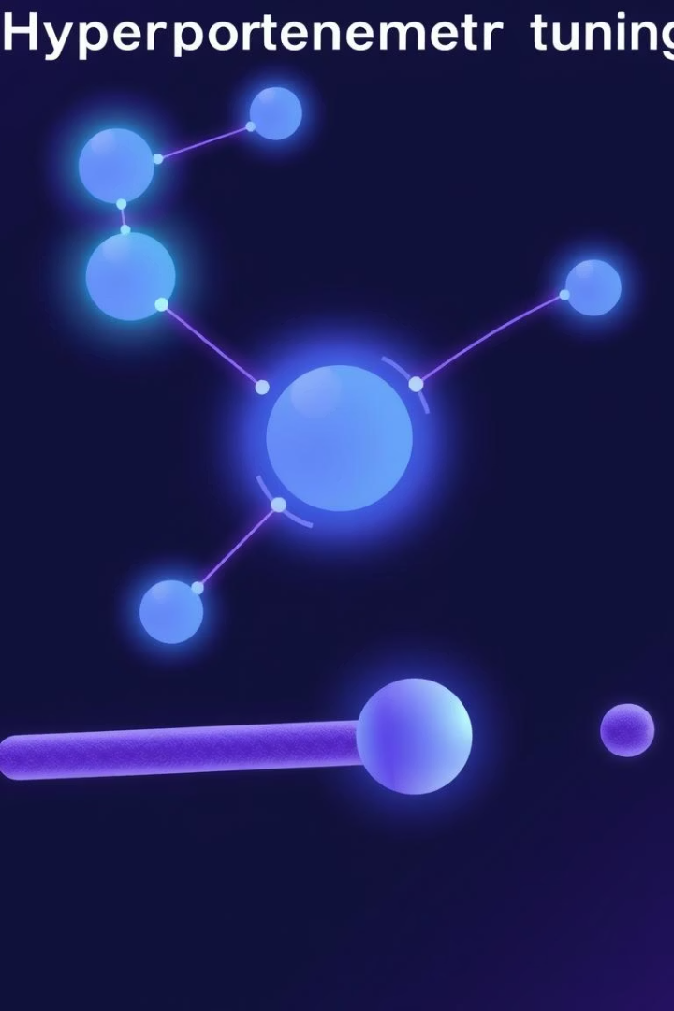
Hyperparameter Tuning Overview
Purpose
Improve model generalization and performance by carefully adjusting
tuning parameters.
Parameters Tuned
LoRA Ranks: Adjusted the low-rank matrix size to balance model complexity and fine-tuning efficiency.
Dropout Rates: Modified dropout to prevent overfitting and stabilize training.
Learning Rates:Experimented with different learning rates to ensure smooth and stable convergence.
Experimental Runs
Four structured runs conducted: ➔ Each varied r, alpha, dropout, and learning rate to evaluate impact on performance.
Notes:
To improve our model’s generalization and overall performance, we carried out hyperparameter tuning by carefully adjusting key training parameters.
We tuned three main aspects: First, the LoRA Ranks, where we adjusted the low-rank matrix size to balance model complexity with fine-tuning efficiency. Second, the Dropout Rates, modifying them to help prevent overfitting and stabilize the training process. And third, we experimented with different learning rates to promote smooth and stable convergence during fine-tuning.
Altogether, we conducted four structured experimental runs, where each run varied the rank (r), scaling factor (alpha), dropout rate, and learning rate to evaluate their impact on model performance

Slide 8
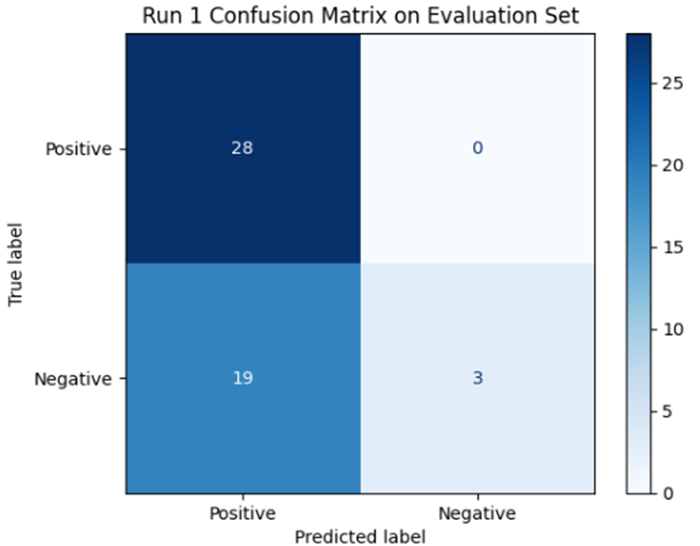
Run 1 and Run 2 Results
Run 1: Setup and Results
LoRA Config: r=32, alpha=64, dropout=0.05, learning rate=2e-4.
Performance:
Accuracy: ~60%
Slightly better training loss stability.
Run 2: Setup and Results
LoRA Config: Same as Run 1, but extended to 2 epochs and targeted more model modules.
Performance:
Accuracy: ~62%
Macro F1 Score: 0.75
Confusion Matrix: Best separation achieved; selected as final model.
Notes:
In Run 1, we used a LoRA configuration with r = 32, alpha = 64, dropout = 0.05, and a learning rate of 2e-4. This setup achieved about 60% accuracy, and we noticed slightly better training loss stability compared to earlier trials.
For Run 2, we kept the same LoRA settings, but made two key changes: we trained for 2 epochs instead of 1, and we targeted more model modules during fine-tuning.
As a result, Run 2 improved to around 62% accuracy and achieved a Macro F1 Score of 0.75. The confusion matrix also showed the best separation between positive and negative classes, so we selected this as our final model.

Slide 9
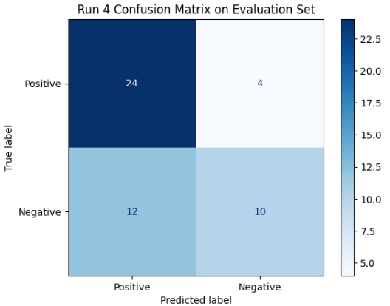
Run 3 & Run 4: Improved Performance
Run 3: Setup and Results
LoRA Config: r=32, alpha=64, dropout=0.1, learning rate=3e-4.
Performance:
Accuracy: ~62%
Macro F1 Score: 0.75
Confusion Matrix: Good separation between Positive and Negative classes.
Run 4: Setup and Results
LoRA Config: r=8, alpha=16, dropout=0.01, learning rate=1e-4.
Performance:
Severe underfitting observed.
Model predicted almost randomly.
Notes:
For Run 3, we used a LoRA configuration with r = 32, alpha = 64, dropout = 0.1, and a learning rate of 3e-4. This setup achieved 62% accuracy, a macro F1 score of 0.75, and a good separation of positive and negative classes in the confusion matrix.
As for Run 4, we used a LoRA configuration with r = 8, alpha = 16, dropout = 0.01, and a learning rate of 1e-4. However, performance suffered as severe underfitting was observed and the model predicted in a random manner.

Slide 10

Best Model Summary & Deployment
Final Best Model
Selected from Run 4 after tuning.
Achieved ~62% Accuracy and 0.75 Macro F1 Score on evaluation set.
Key Highlights
Stable convergence even with 2 epochs.
No major overfitting observed.
Balanced performance across Positive and Negative classes.
Deployment Ready
Only LoRA adapter weights saved.
Model ready for lightweight loading and deployment.
Notes:
The best model was selected from Run 4 after tuning, achieving 62% accuracy and a 0.75 macro F1 score on the evaluation set, with balanced performance across classes.
Key highlights:
Stable convergence in just 2 epochs.
No major overfitting.
Balanced performance between Positive and Negative classes.
For deployment, we saved only the LoRA adapter weights, making the model lightweight and ready for quick integration into production systems.

Slide 11

Thank you!

